Slide 1
Studying the Effects of Rare Variants in Metabolic Syndrome
A bioinformatics Prelims Proposal by Chinmay Raut
(April 24th)

Slide 2
Agenda
Metabolic Syndrome
Rare Variants
Big Biological Question
Aim 1: Determining Novel Gene-Based Associations
Aim 1a: Identify genes associated with components of disease
Aim 1b: Integrate discovered signals to study holistic effect on disease
Aim 2: Determining sequence-specific mechanisms of disease
Aim 2a: Within a gene, identify loci of individual variants affecting MetS
Aim 2b: Design CRISPR CAS9 KO guide library for MetS
Conclusion

Slide 3
Metabolic Syndrome (MetS)

Slide 4
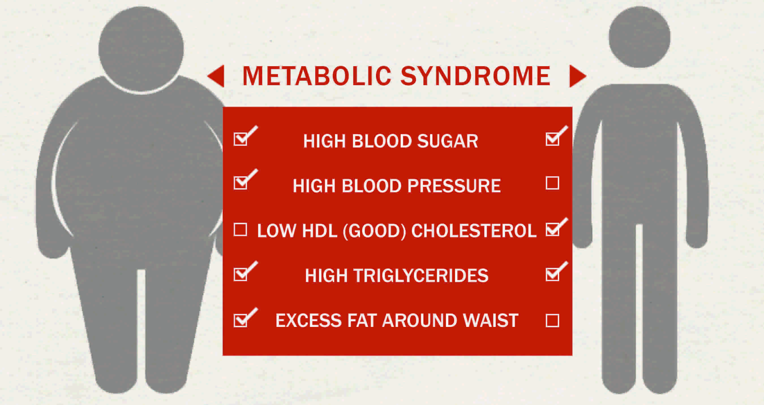
Metabolic Syndrome (MetS) is a cluster of conditions
Defined as at least 3 of 5 risk factors
Increased risk of health complications
heart disease
stroke
type 2 diabetes (T2D)
American Institute for cancer research, Saklayen et al. (2018)

Slide 5
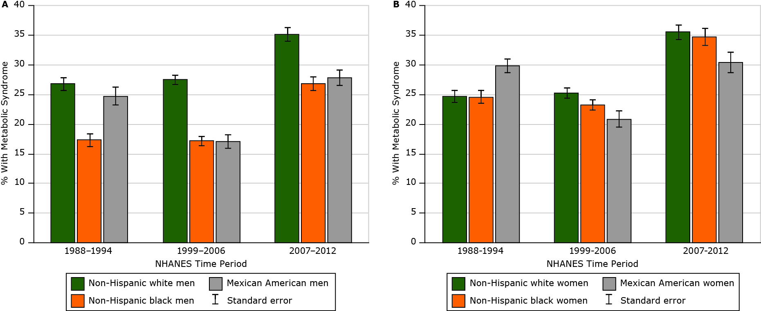
MetS affects ~⅓ Americans with upward trend over time
Moore et al. 2017

Slide 6
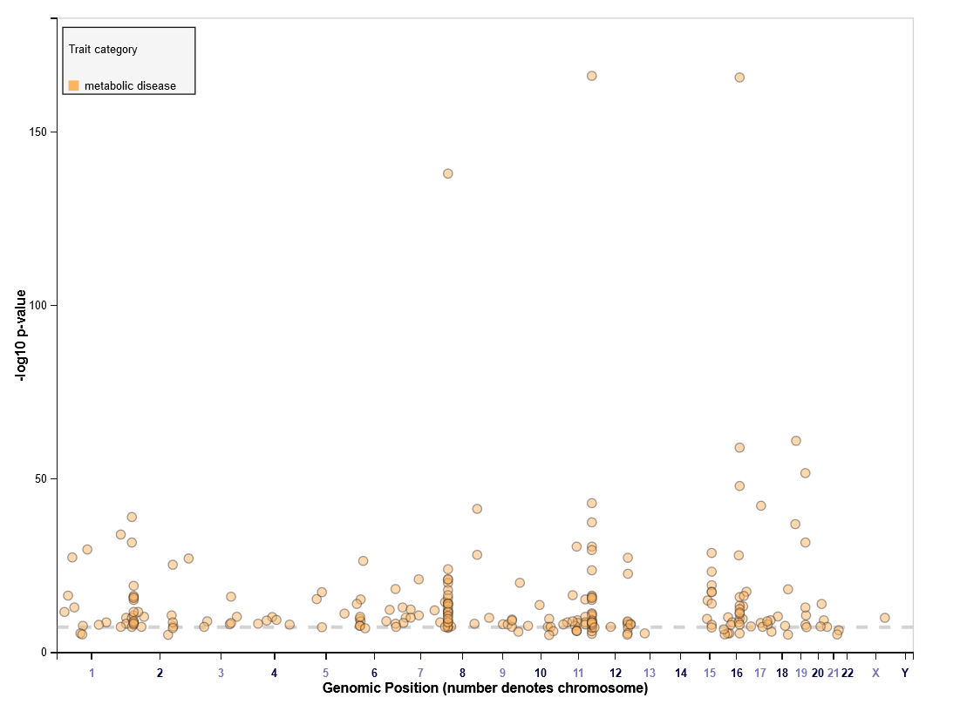
MetS has a genetic component
Both environmental & genetic factors associated with MetS
Genetics can help resolve biological basis of disease
241 reported associations with MetS
estimated to be about 20-30% heritable
Associated hits implicate lipid metabolism
example: LPL, CETP
CETP
LPL
Manhattan of MetS GWAS results from GWAS catalogue
GWAS catalogue, Graziano et al. (2019)

Slide 7
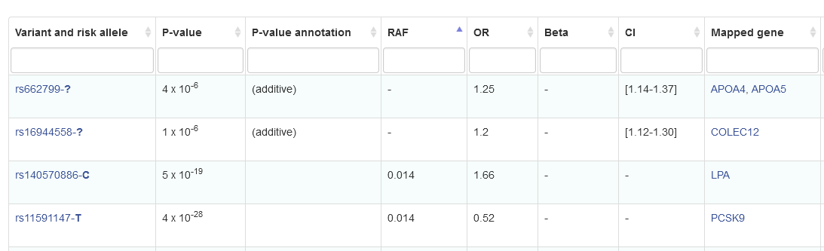
Current large-scale MetS GWAS neglect rare variants
No one has reported variants with minor allele frequencies (MAF) < 1%
A Korean study of 12,067 participants was able to implicate 1 in CETP
GWAS catalogue, Lee et al. (2018)

Slide 8
Rare Variants (MAF < 1%)

Slide 9
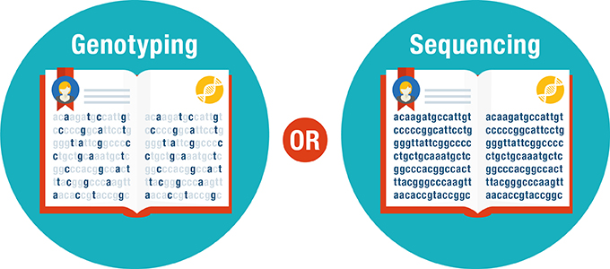
Advancements in Sequencing allow study of rare-variants
(old way) Use short-reads to know few locations in the genome and impute the rest
(newer way) Use long-reads & different locations to know exact sequence in the genome
National society of Genetic Counselors

Slide 10
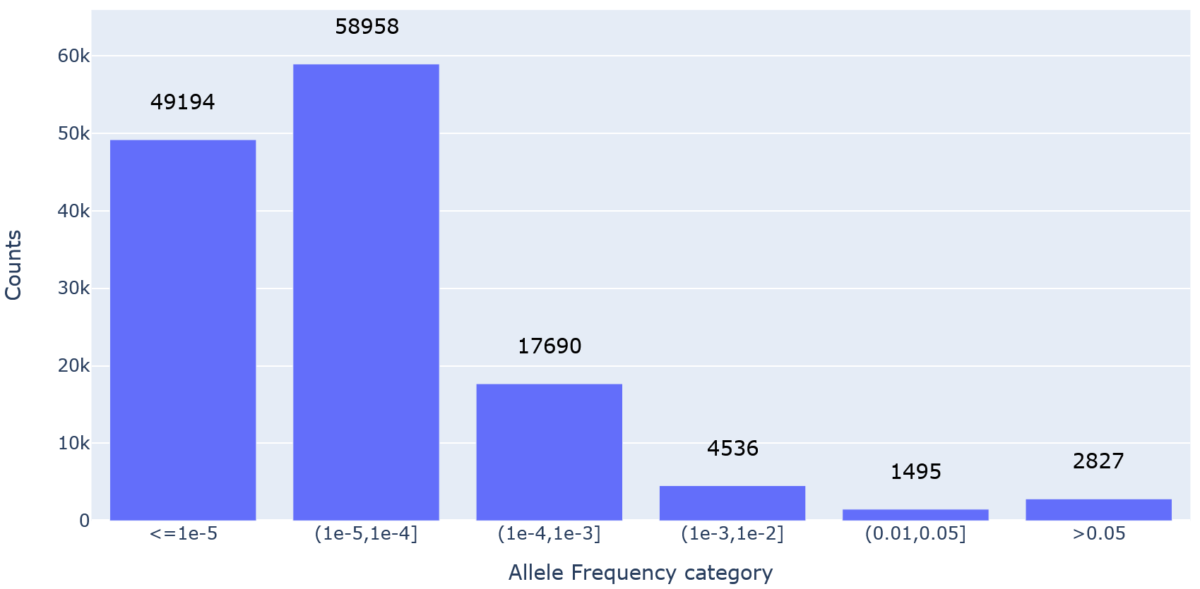
Why Rare variants? → make up most sites of variation
They make up most sites of variation across a genome
Most of of sequence data is rare variants (>90%)
Barcharts of allele frequency categories from 130,000 random variants selected from chromosome 22 UKBB WES
Backman et al. (2021)

Slide 11
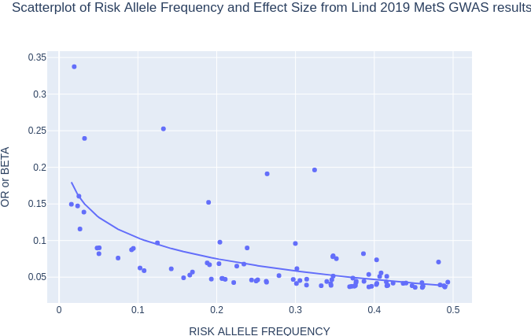
Why Rare variants? → tend to have stronger effect sizes
estimates of variant effect sizes tend to increase as MAF decreases
rare-variants have stronger phenotypic effects than common variants
Lind et al. (2019)

Slide 12
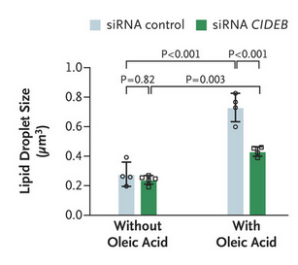

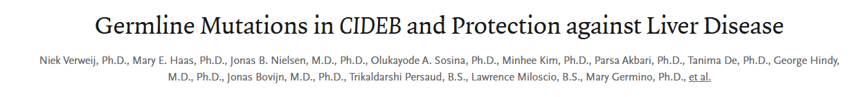
Why Rare Variants → if exonic can direct treatment
common variant hits often lie between 2 genes
or have epigenetic effects
focus on just exonic rare variants
no need for fine-mapping
directs biological understanding/treatment
CIDEB was a rare-variant hit for fatty liver. Cells with CIDEB small-interfering RNA (siRNA) result in less lipid droplets
(2022)

Slide 13

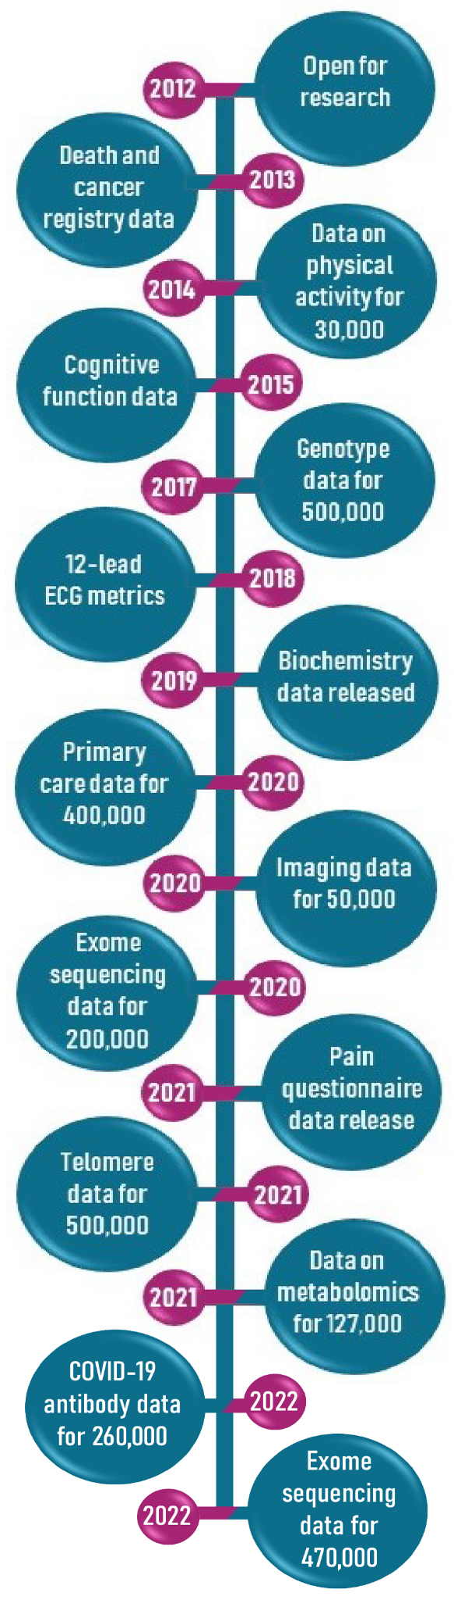
Biobanks have begun to release their sequence data
UK Biobank (UKBB)
~500k European individuals
genetic & phenotypic data
released whole exome data (WES)
26 million variants
Michigan Genomics Initiative (MGI)
70,439 Individuals
genomic data & hospital records
released TopMed imputed WGS
~300 million variants
Backman et al. (2021), Zawistowski et al. (2023)

Slide 14
Big Biological Question

Slide 15
Using WES and WGS from large Biobanks such as MGI and UKBB, what role do rare, protein-coding variants play on MetS, and how can they inform novel therapies or further our understanding of the disease?

Slide 16
4 sub aims
Aim 1: Determining Novel Gene-Based Associations
Aim 1a: Identify genes associated with components of disease
Aim 1b: Integrate discovered signals to study holistic effect on disease
Aim 2: Determining sequence-specific mechanisms of disease
Aim 2a: Within a gene, identify loci of individual variants affecting MetS
Aim 2b: Design CRISPR CAS9 KO guide library for MetS functional tests

Slide 17
Aim 1: Determining Novel Gene-Based Associations

Slide 18
Aim 1a: Identify genes associated with components of disease
MetS consists of 5 individual components
blood pressure
serum glucose
serum triglycerides
waist circumference
HDL cholesterol
Deal with Components of MetS individually 1-by-1
Account for genetic associations across single components
Or in opposing directions across components
Increases power of the study

Slide 19
Rare Variants need Special Care
Common variants in same spot
(single variant analysis)
Rare Variants are in different spots
(set/region-based analysis)
X
X
Gene
Gene
X
X
Gene
Gene
X
X
Gene
Gene
X
X
X
X
All variants needed to be in same spot
Now variants can be in different locations of the gene to identify association
Gene-based analysis == set-based analysis
pool together rare variants from similar regions to increase power

Slide 20
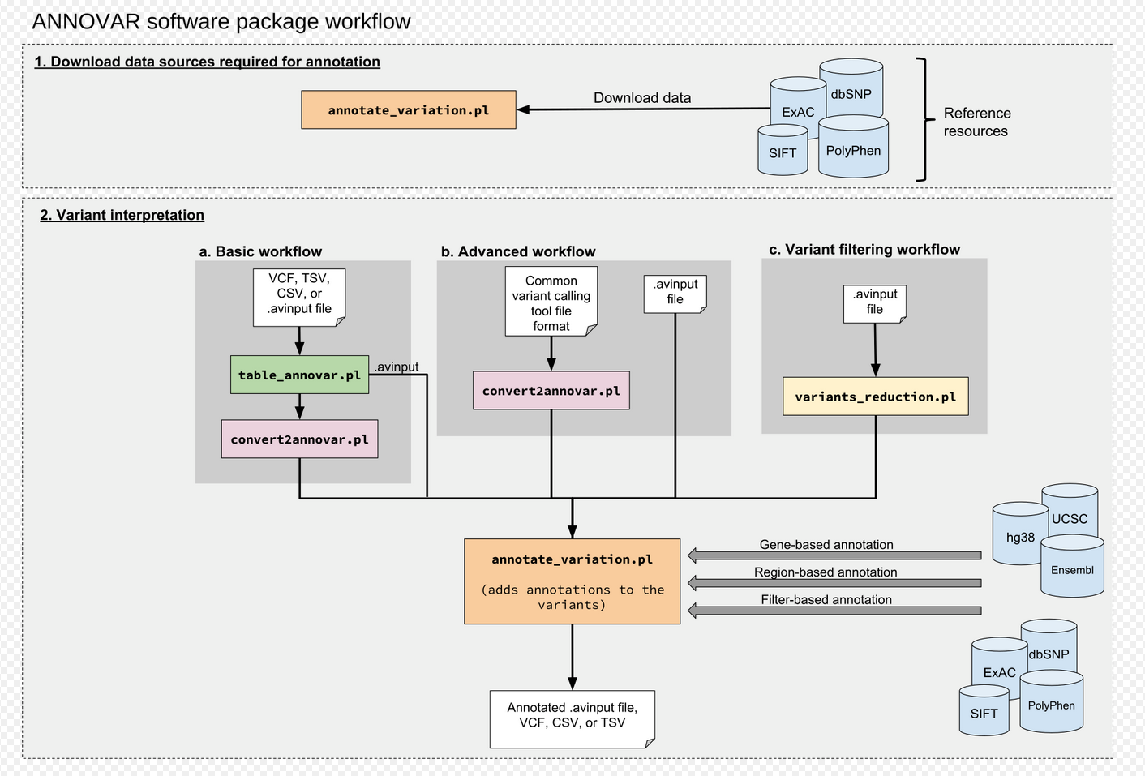
Build Variant Sets via Gene Annotation (Annovar)
split variants into exonic & non-exonic
Focus on:
Loss of Function (LoF)
Missense
Synonymous Variants
Wang et al. (2010)

Slide 21
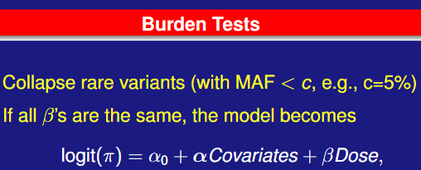
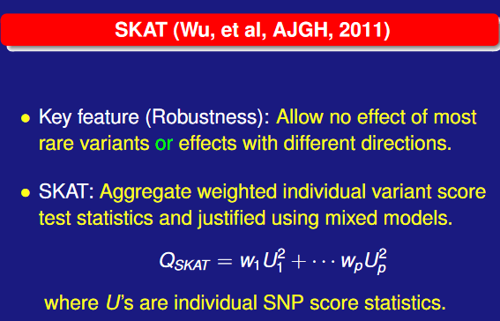
SKAT-O Test → Leading Technique for Gene-Based Tests
Combination of Burden & SKAT tests
Burden Better when Large % of variants causal & effects in same direction
SKAT more powerful when small % of variants causal or effects have mixed directions
Both can happen in a genome
Lee et al. (2012)

Slide 22
6 step process to address aim 1a
Quality Control WES
Annotate Variants
Filter variants based on MAF and annotation
Construct phenotypes (adjust for medication)
Run SKAT-O tests using SAIGE-GENE+
Run conditional tests using SAIGE-GENE+
We should be left with a list of genes each implicated with a component of MetS

Slide 23
Potential Pitfalls & alternatives
low-power with rare-variant associations
large mutation/WT imbalances
low proportion of truly causal variants in SKAT-O
Subdivide list of variants within gene
MAF categories
Sliding window approach

Slide 24
Aim 1b: Integrate discovered signals to study holistic effect on disease
Studying 5 factors independently ignores joint & diverse nature of disease
Use component-wise results to inform & study disease as whole
Run rare-variant GWAS on MetS diagnosis

Slide 25
8 step process to address aim 1b
Construct MetS diagnosis in UKBB
implicate new EWS genes
Validate UKBB results using MGI
Construct MetS diagnosis in MGI
Run SKAT-O tests using SAIGE-GENE+
implicate replicated component genes
Identify MetS genetic disease subtypes
Improve MetS risk scores via new rare variant hits
We should be left with a list of genes each implicated with MetS, genetic disease subtypes, & improved MetS Genetic Risk Scores (GRS)

Slide 26
Potential Pitfalls & alternatives
High case-control imbalance
UKBB → MetS prevalence of 25%
Lower power with GWAS of binary trait
fail to implicate genes
Use MetS severity score (quantitative trait)
Replication uses different sequencing approach
TopMed rare-variant imputation
Too few variants pass QC for gene-based approach
Drop R2 threshold to 0.3 for rare-variants (proposed by TopMed)
Lind et al. (2019), Low et al. (2019), Tailun et al. (2021)

Slide 27
Aim 2: Determining sequence-specific mechanisms of disease

Slide 28
Aim 2a: Within a gene, identify loci of individual variants affecting MetS
Construct framework to functionally assess implicated MetS genes
Are implicated genes holistically associated with MetS?
Or are portions of genes more/less associated with MetS?

Slide 29
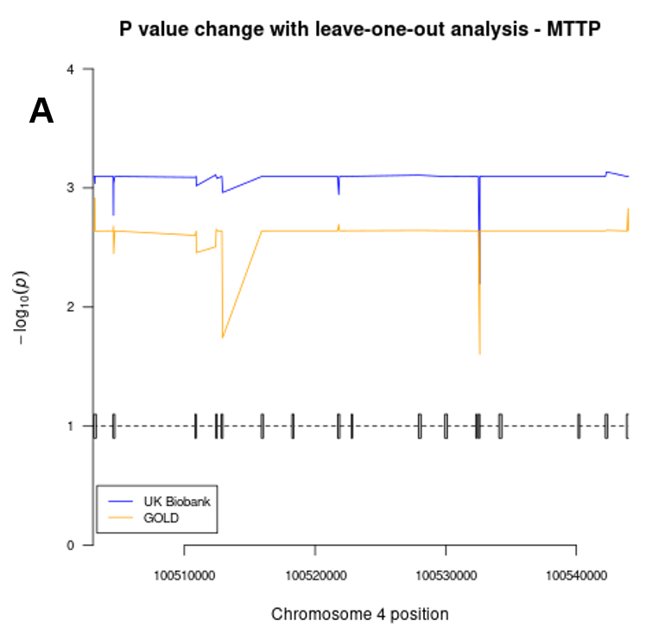
Leave-One-Variant-Out Tests show contribution of single variants
More influential regions of a gene, LOVO causes large change in association
Less influential regions cause smaller associations
Can be identified through local peak finding
Du et al. (2021)

Slide 30
5 step process to address aim 2a
Study folded proteins via simulations (AlphaFold)
Perform LOVO studies for implicated variants
identify region specific associations with genes
Verify by conducting follow up gene-based test
Produce left & right endpoints for MetS loci within genes
Expect to have list of genomic endpoints for each gene implicating important parts relating to MetS
Jumper et al. (2021)

Slide 31
Potential Pitfalls & alternatives
No single locus seems to be enriched for rare-variants associating with MetS
Cannot identify a single smaller causal region
Implicate multiple loci or implicate entire gene
Assumes that changes in association are due to the presence or absence of those rare-variants only
other cis/trans effects are not considered
Verify that implicated variants are not associated with other genetic data
methylation/enhancer sites

Slide 32
Aim 2b: Design CRISPR CAS9 KO guides based on exonic variants
Most functional tests knock-out (KO) or remove entire function or presence of gene to study lack of effect
From 2a, specific portions/mutations of gene associate with MetS
not just presence/absence
In order to promote functional tests
CAS9 / guide library to test these gene portion associations
Perk et al. (2005)

Slide 33
4 step approach to address aim 2b
Identify CAS9 guides using CRISPOR or CHOPCHOP
For gene loci from 2a identify relevant CAS9 guides
Verify subset of original guides will be effective using CRISPick
Functionally validate CAS9 guide library via KO & sequence
expect to receive a set of CAS9 rna-guides for each MetS-implicated gene that can directly be applied to a functional study of MetS for an in-vitro model
Concordet et al. (2018), Labun et al. (2019), Pedrozo et al. (2022)

Slide 34
Potential Pitfalls & alternatives
CAS9 cutting may not be precise
CRISPick can help
Functional results needed to verify guide library
For given region, no guides can be automatically constructed
Wider regions to remove
Longer guide RNAs

Slide 35
Conclusions

Slide 36
Studying effects of Rare-Variants on MetS is Important
MetS is a complicated and widely prevalent condition
Bridge the gap of effects of rare-variants on MetS using large sample sizes
Aim 1: Determining Novel Gene-Based Associations
Aim 1a: Identify genes associated with components of disease
Aim 1b: Integrate discovered signals to study holistic effect on disease
Aim 2: Determining sequence-specific mechanisms of disease
Aim 2a: Within a gene, identify loci of individual variants affecting MetS
Aim 2b: Design CRISPR CAS9 KO guide library for MetS
Hope to achieve additional high effect-size MetS associated genes with functional follow up potential through CAS9 library
Proposed study is primarily in-silico, in-vitro follow ups are required to verify

Slide 37
Thanks for listening, Questions?

Slide 38
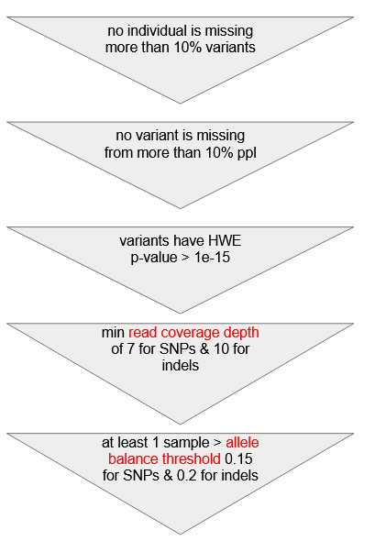
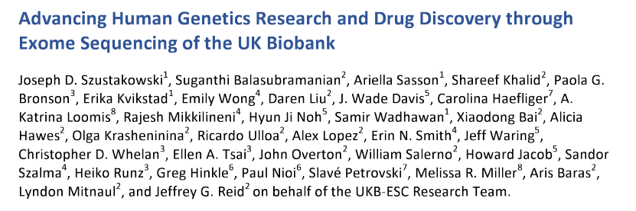
UKBB 500k WES QC updates (5 main filters)
QC Process
Based on Report by UKBB

Slide 39
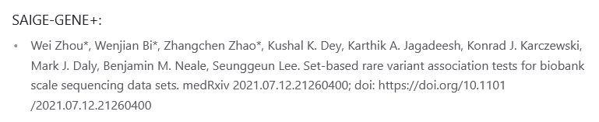
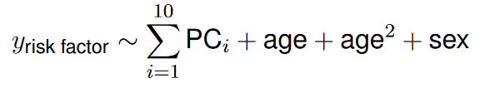
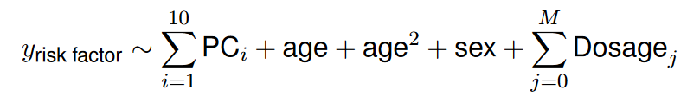
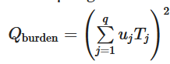
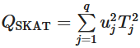
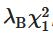
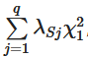
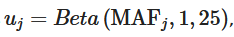
Use SAIGE-GENE+ implementation for SKAT-O tests
null model:
conditional model:
test statistics:
Zhou et al. (2020)

Slide 40
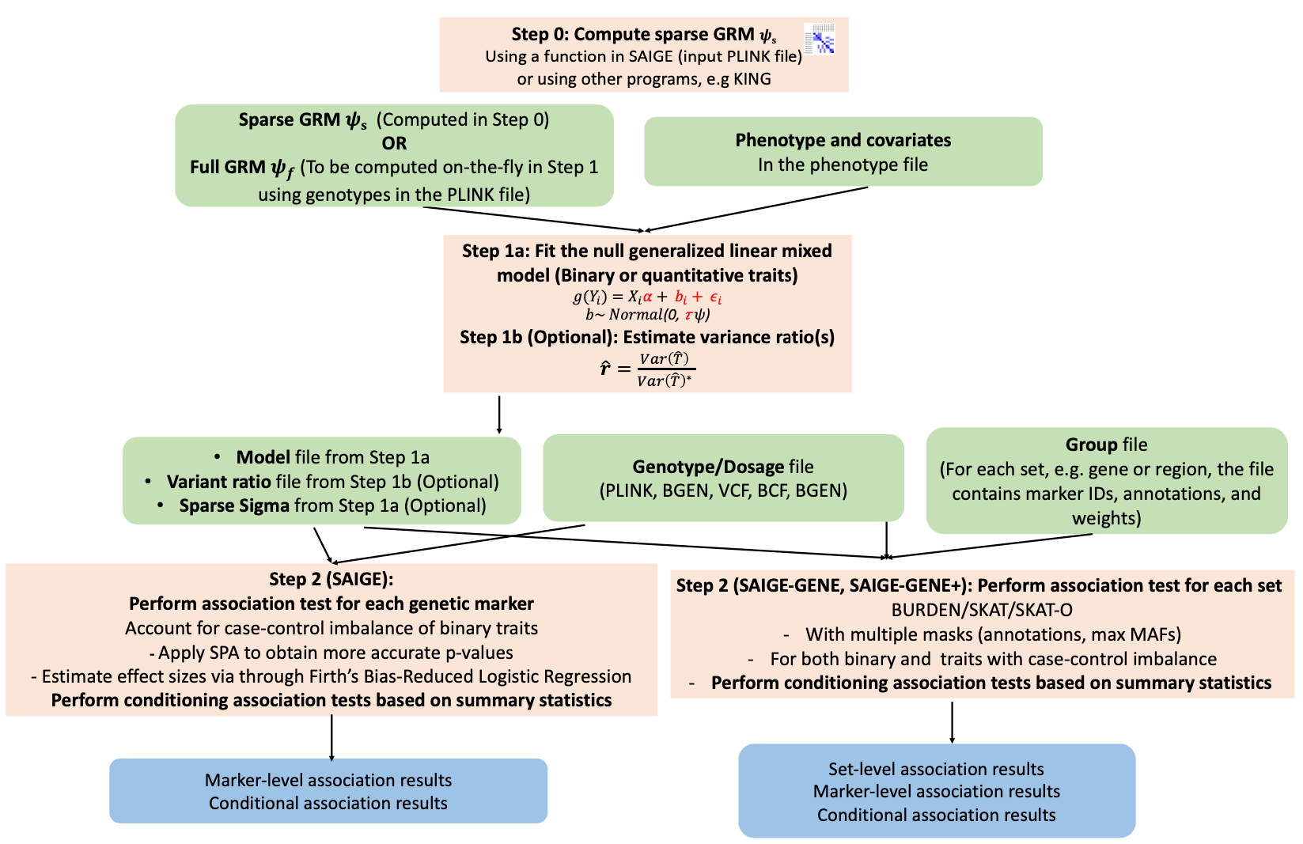

Slide 41
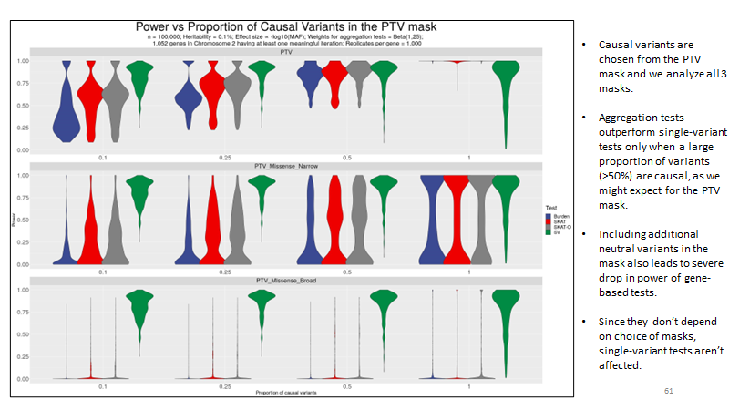
Bose et al. (2022)

